Slide 1

Cohort Differences in Gun Use and Exposure to Gun Violence in a 25-year Study of Chicago Children
Charles C. Lanfear
Robert J. Sampson
David S. Kirk
Rebecca Bucci

Slide 2


Project on Human Development in Chicago Neighborhoods, 1995-2022
Sampson, Robert J., David S. Kirk, and Rebecca Bucci. 2022. "Cohort Profile: Project on Human Development in Chicago Neighborhoods and Its Additions (PHDCN+)." Journal of Developmental and Life-Course Criminology 8: https://doi.org/10.1007/s40865-022-00203-0.

Slide 3
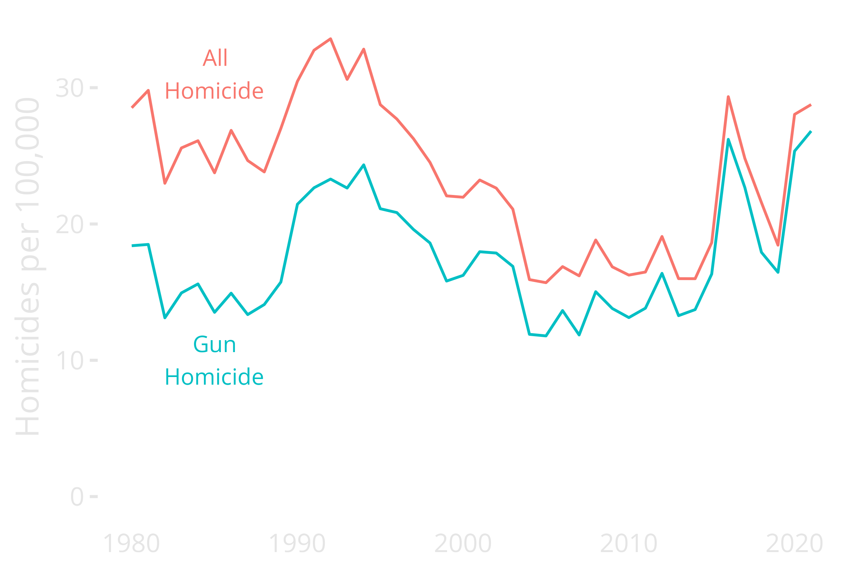
The Changing Nature of Lethal Violence
in Chicago Over the Last 40 Years
Notes:
Enormous variation in homicide; early 1990s peak was double the period 2005-2015
Resurgence since 2016
Proportion with guns increasing over time---actually more gun hom in 2016, 20, 21 than mid 1990s
Even during low periods, this is ten or more times the homicide rate of major European cities

Slide 4

Questions
How do changing historical macro-social conditions shape the likelihood of individuals…
using guns?
being exposed to gun violence?
Notes:
We’ll be focusing mostly on cohort here; last session focused on race, sex, and neighborhood conditions.

Slide 5


Slide 6

PHDCN (1995-2002)
Longitudinal study of 6,200 children
7 cohorts in 1995: 0 (infant), 3, 6, 9, 12, 15, and 18
Probability samples from 80 neighbourhoods
Stratified by race and social class
Three waves, 1995-2002
Parents/caretaker and child assessments
75-78% response rates
Community surveys of 343 neighborhoods
1995 and 2002-2003

Slide 7
PHDCN+ Wave 4 (2011-2012)
N = 1,057, nationwide field effort (funded by MacArthur Foundation)
Random sample of cohorts 0, 9, 12, and 15
63% response rate
Diverse sample:
40% Latino/Hispanic
37% Black
19% White

Slide 8
PHDCN+ Wave 5 (May-Oct 2021)
N = 682, multi-mode survey: web, phone, F2F
66% response rate
Official criminal justice histories, 1995-2020
Planned through 2023

Slide 9
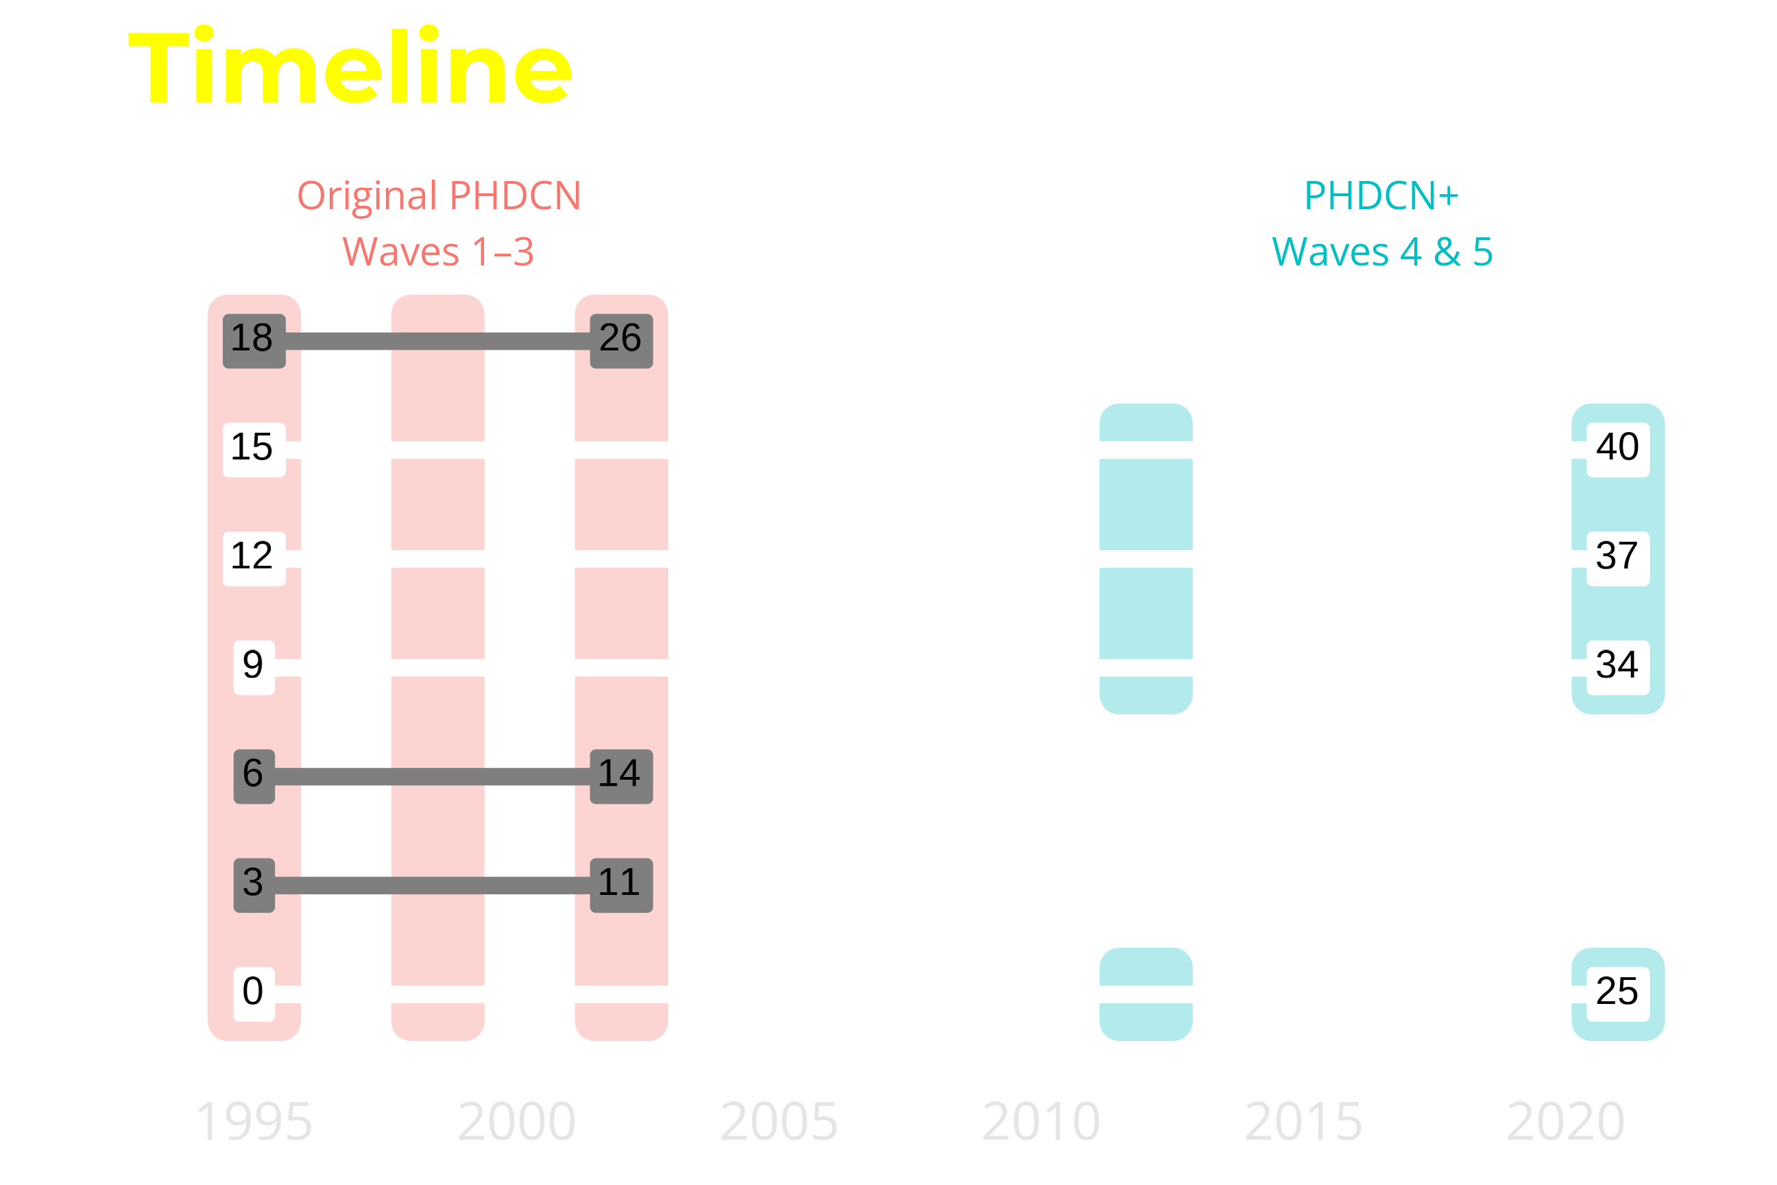
Notes:
PHDCN+ covers much longer time period than original PHDCN: Age 0 to 40, 25 years within each cohort
Well past peak criminal involvement and exposure ages

Slide 10
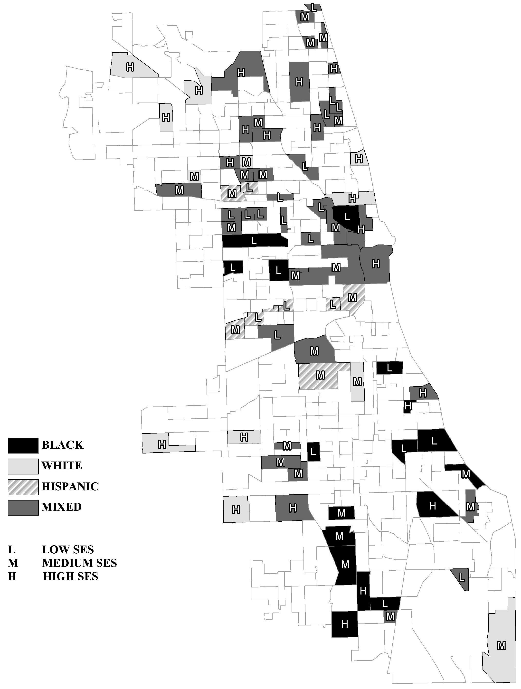
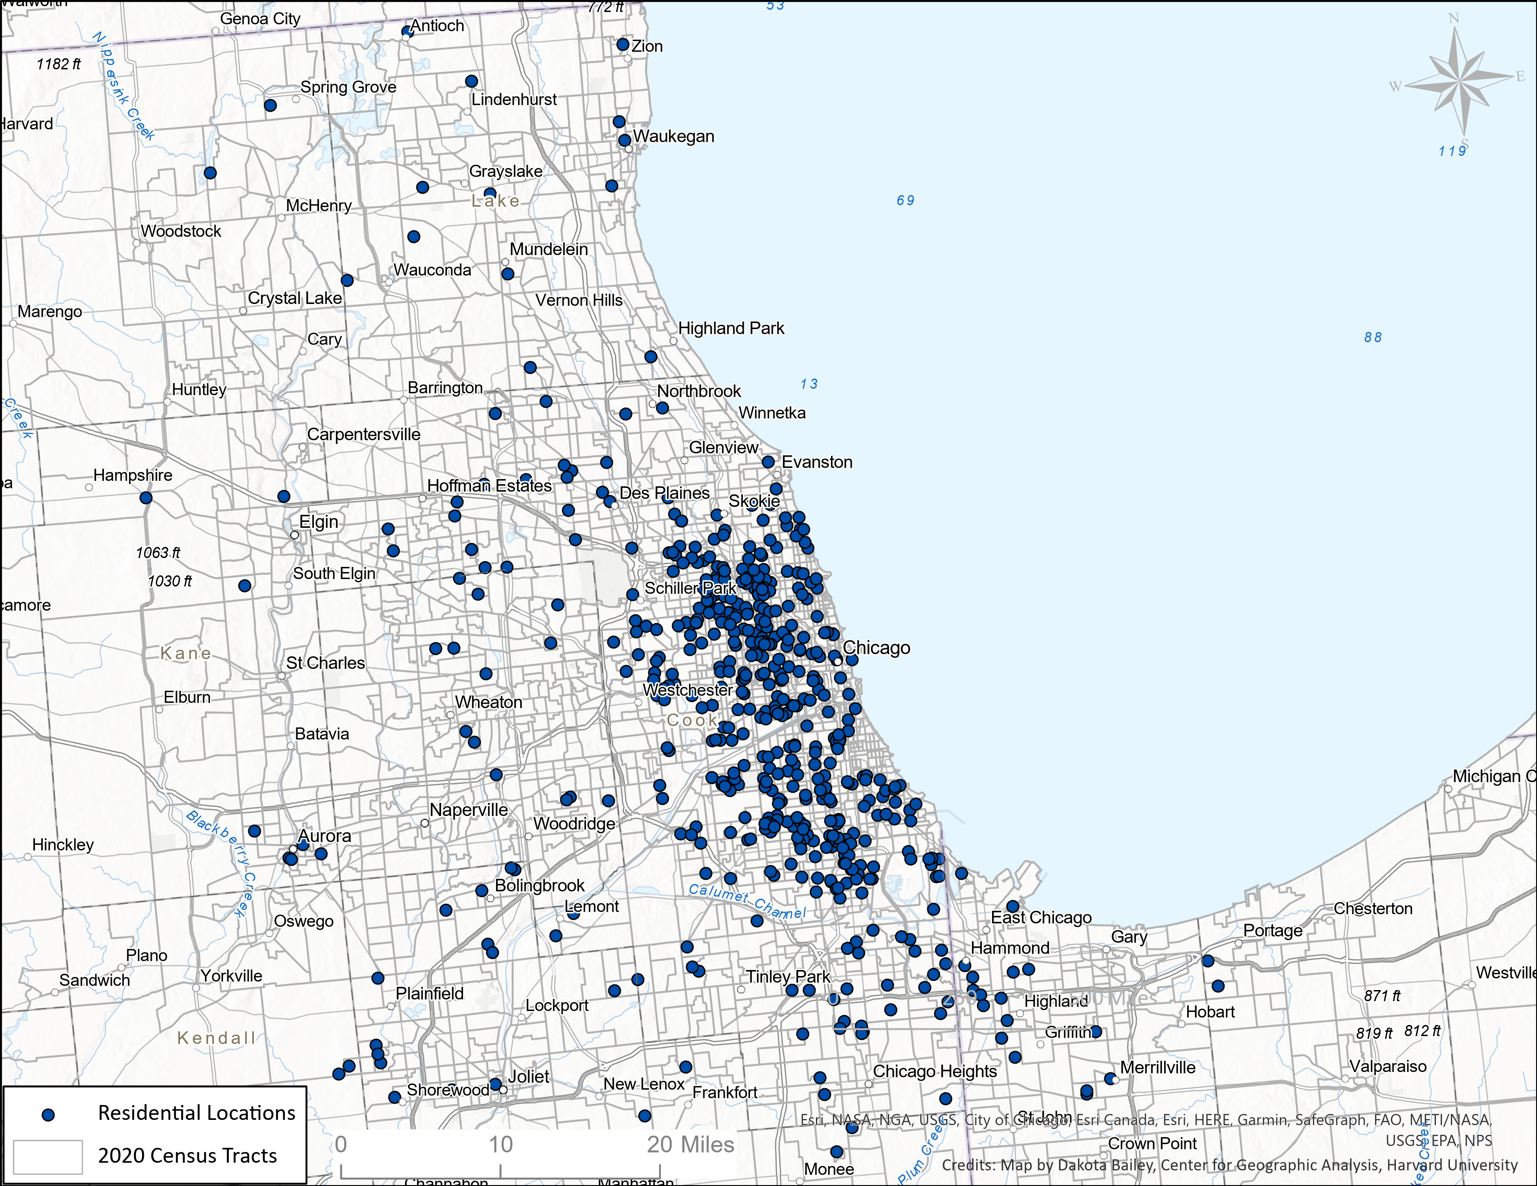
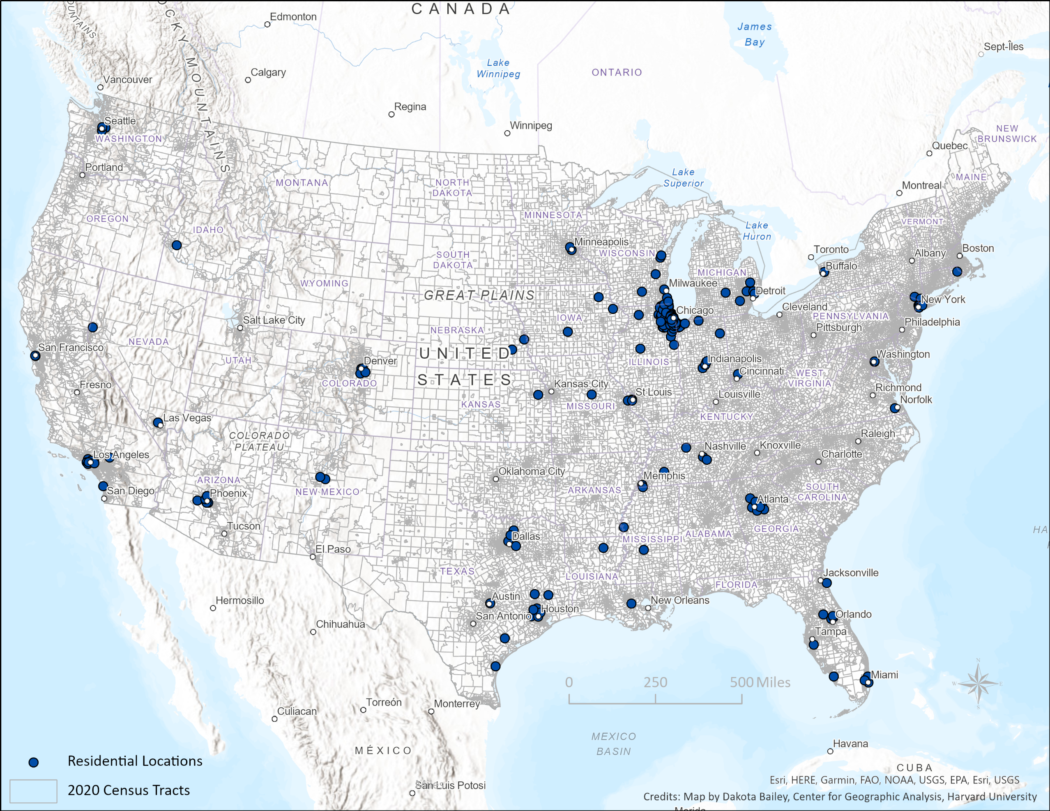
1995
Where are they as of 2021?

Slide 11
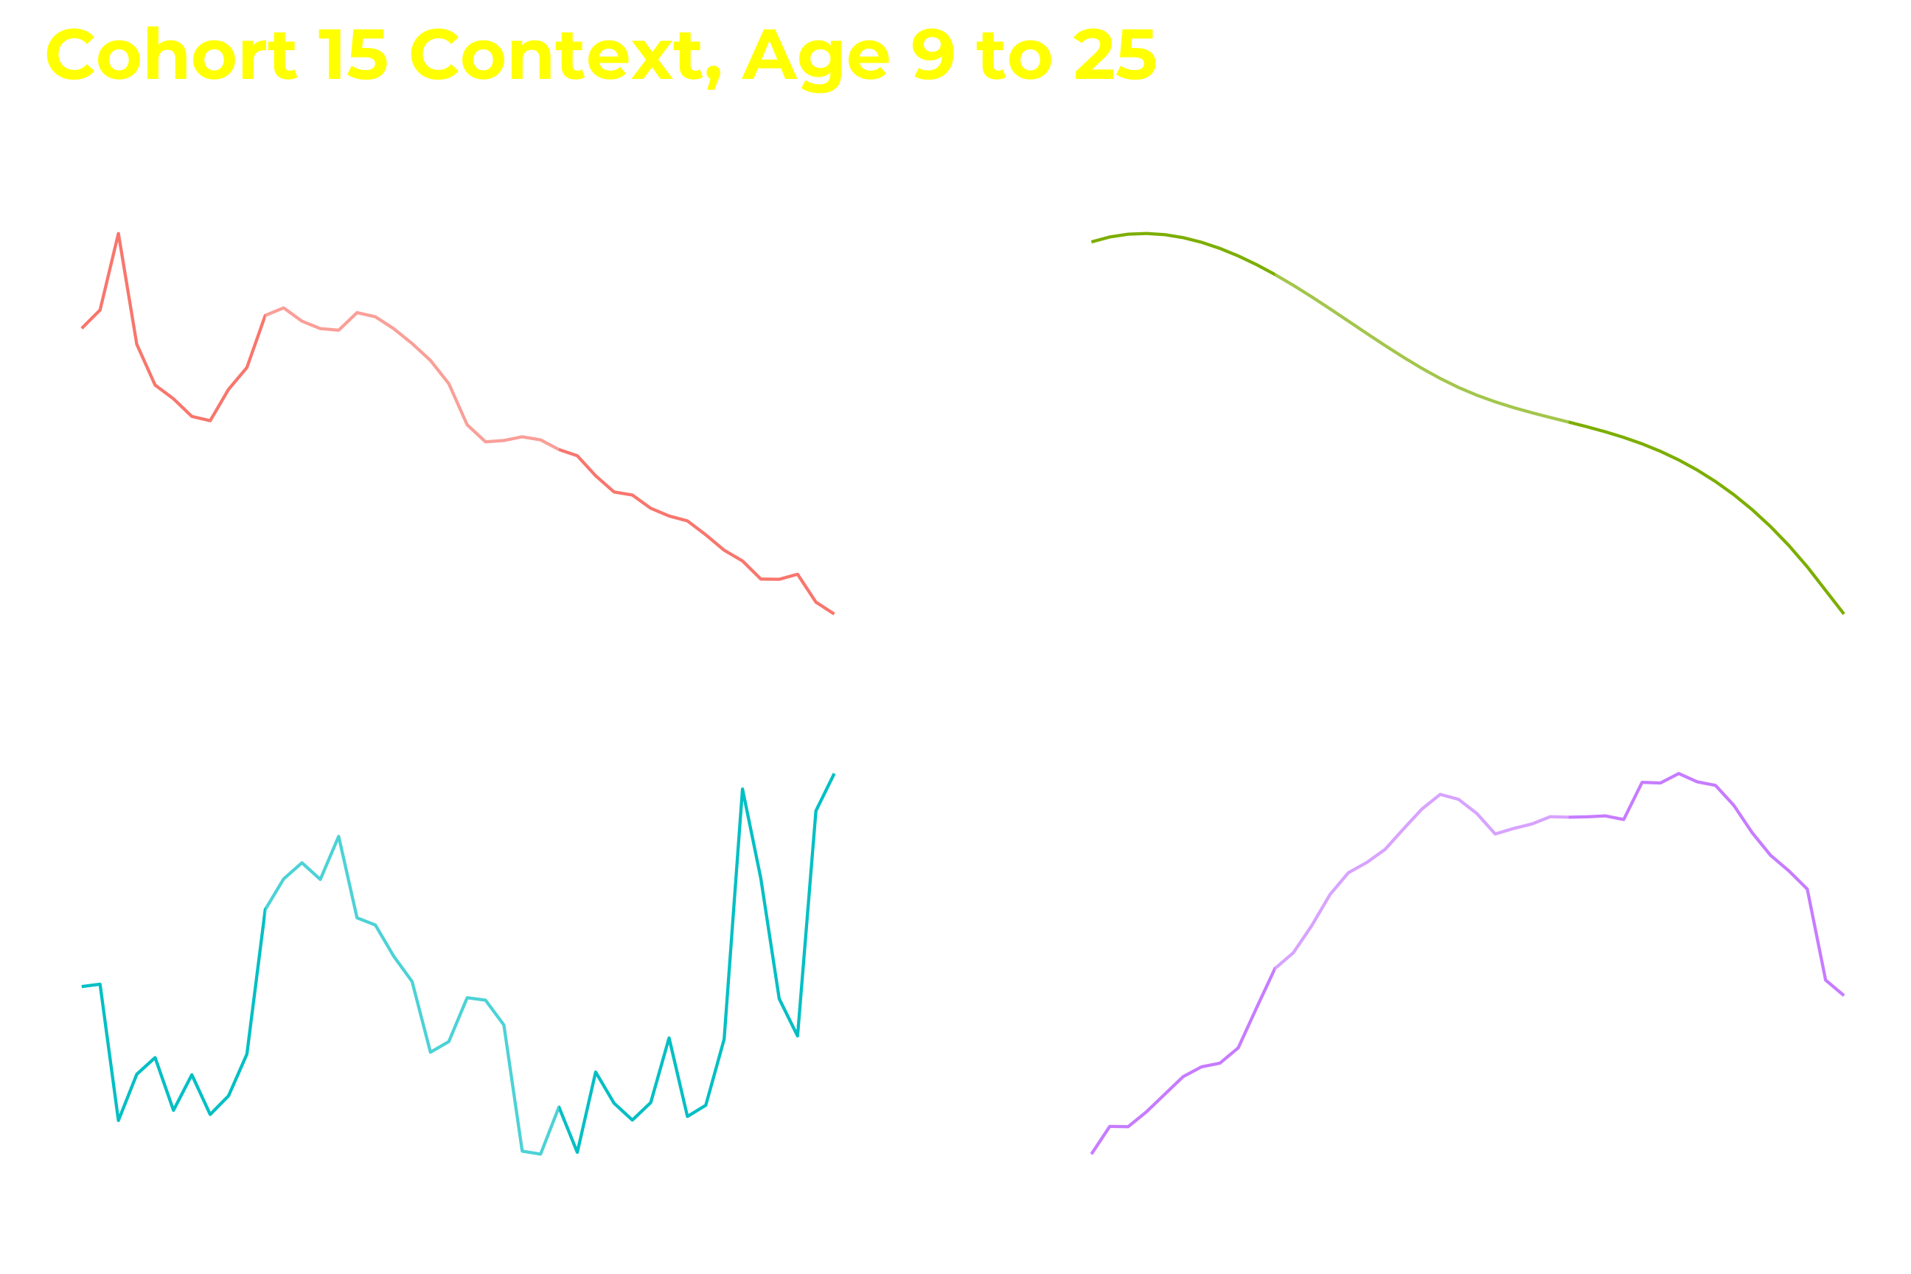
Notes:
Align by age instead of year—see age-specific contexts for gun violence, incarceration, disadvantage.
Age 13 to 25 highlighted as peak risk period—different patterns for all cohorts

Slide 12
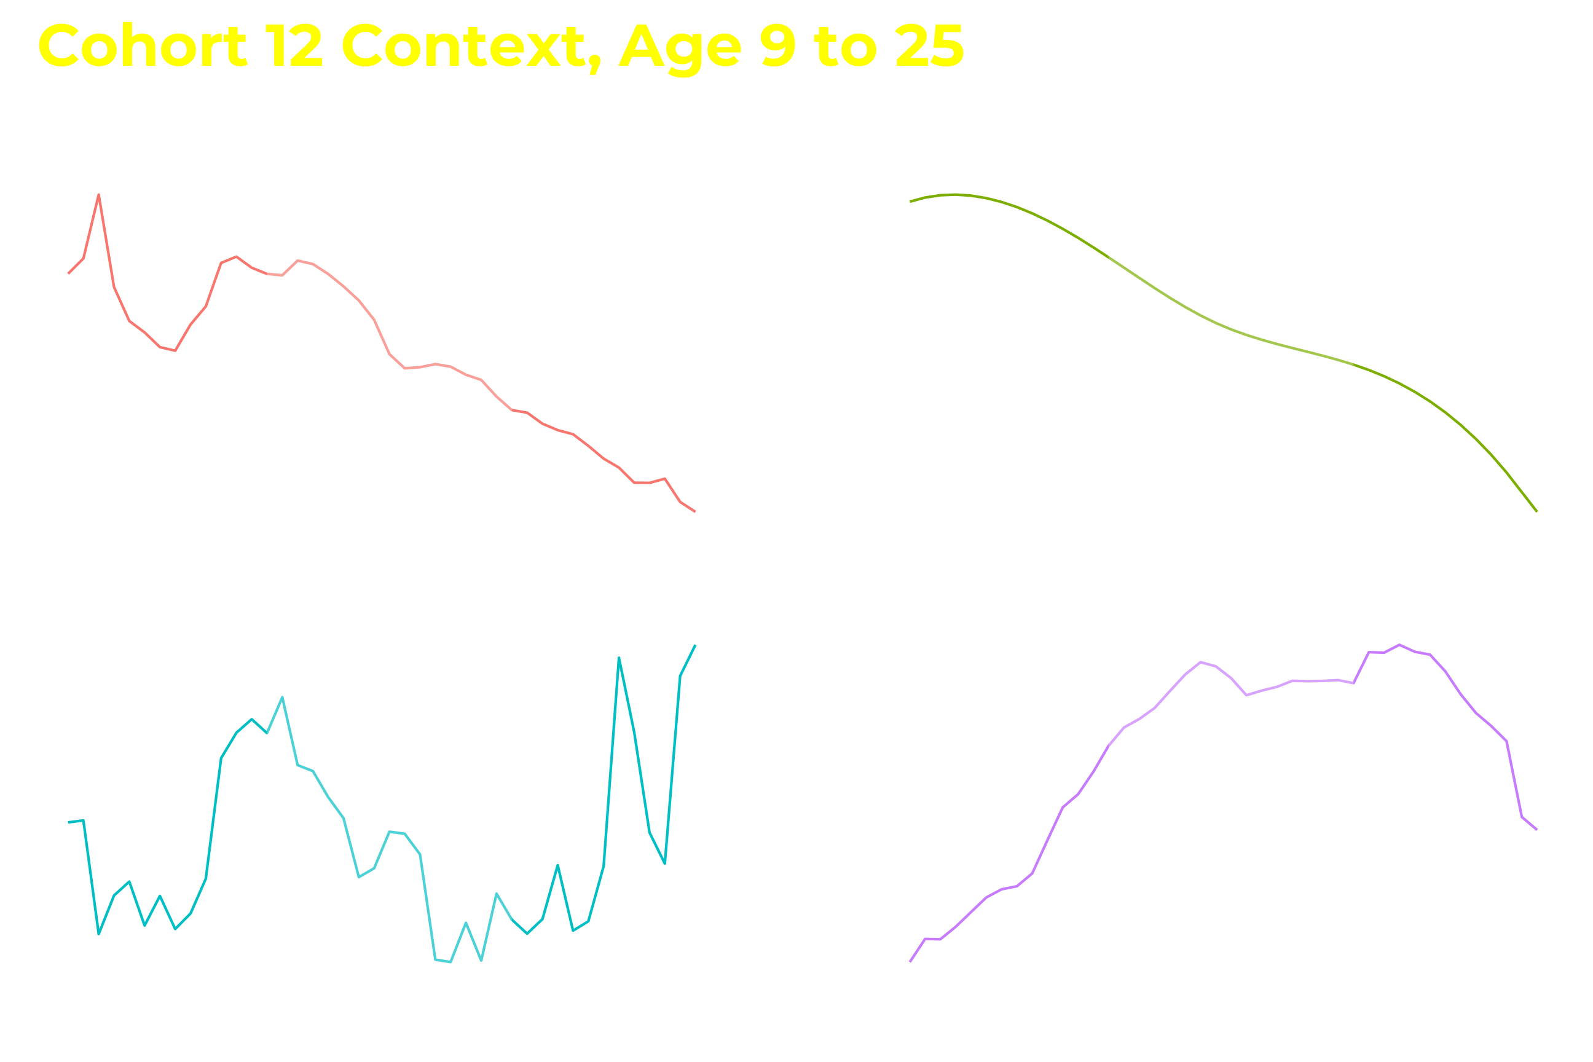

Slide 13
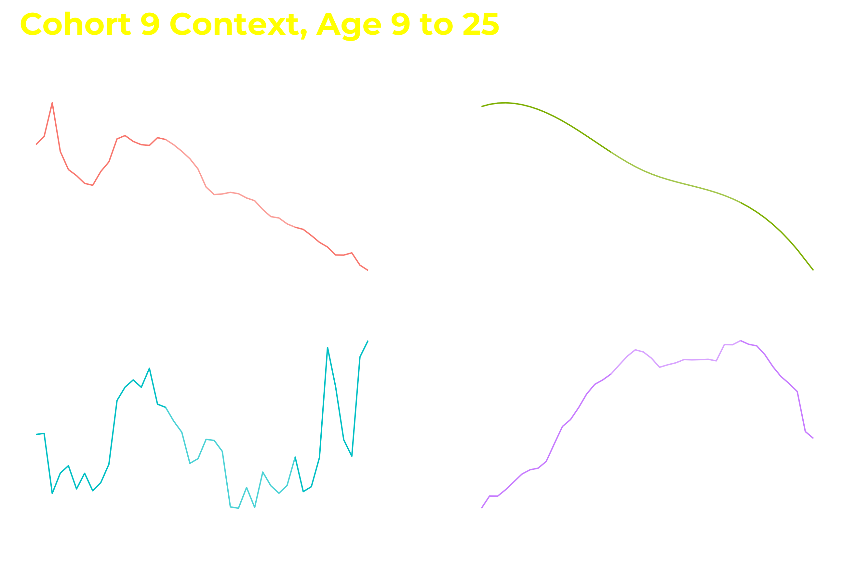

Slide 14
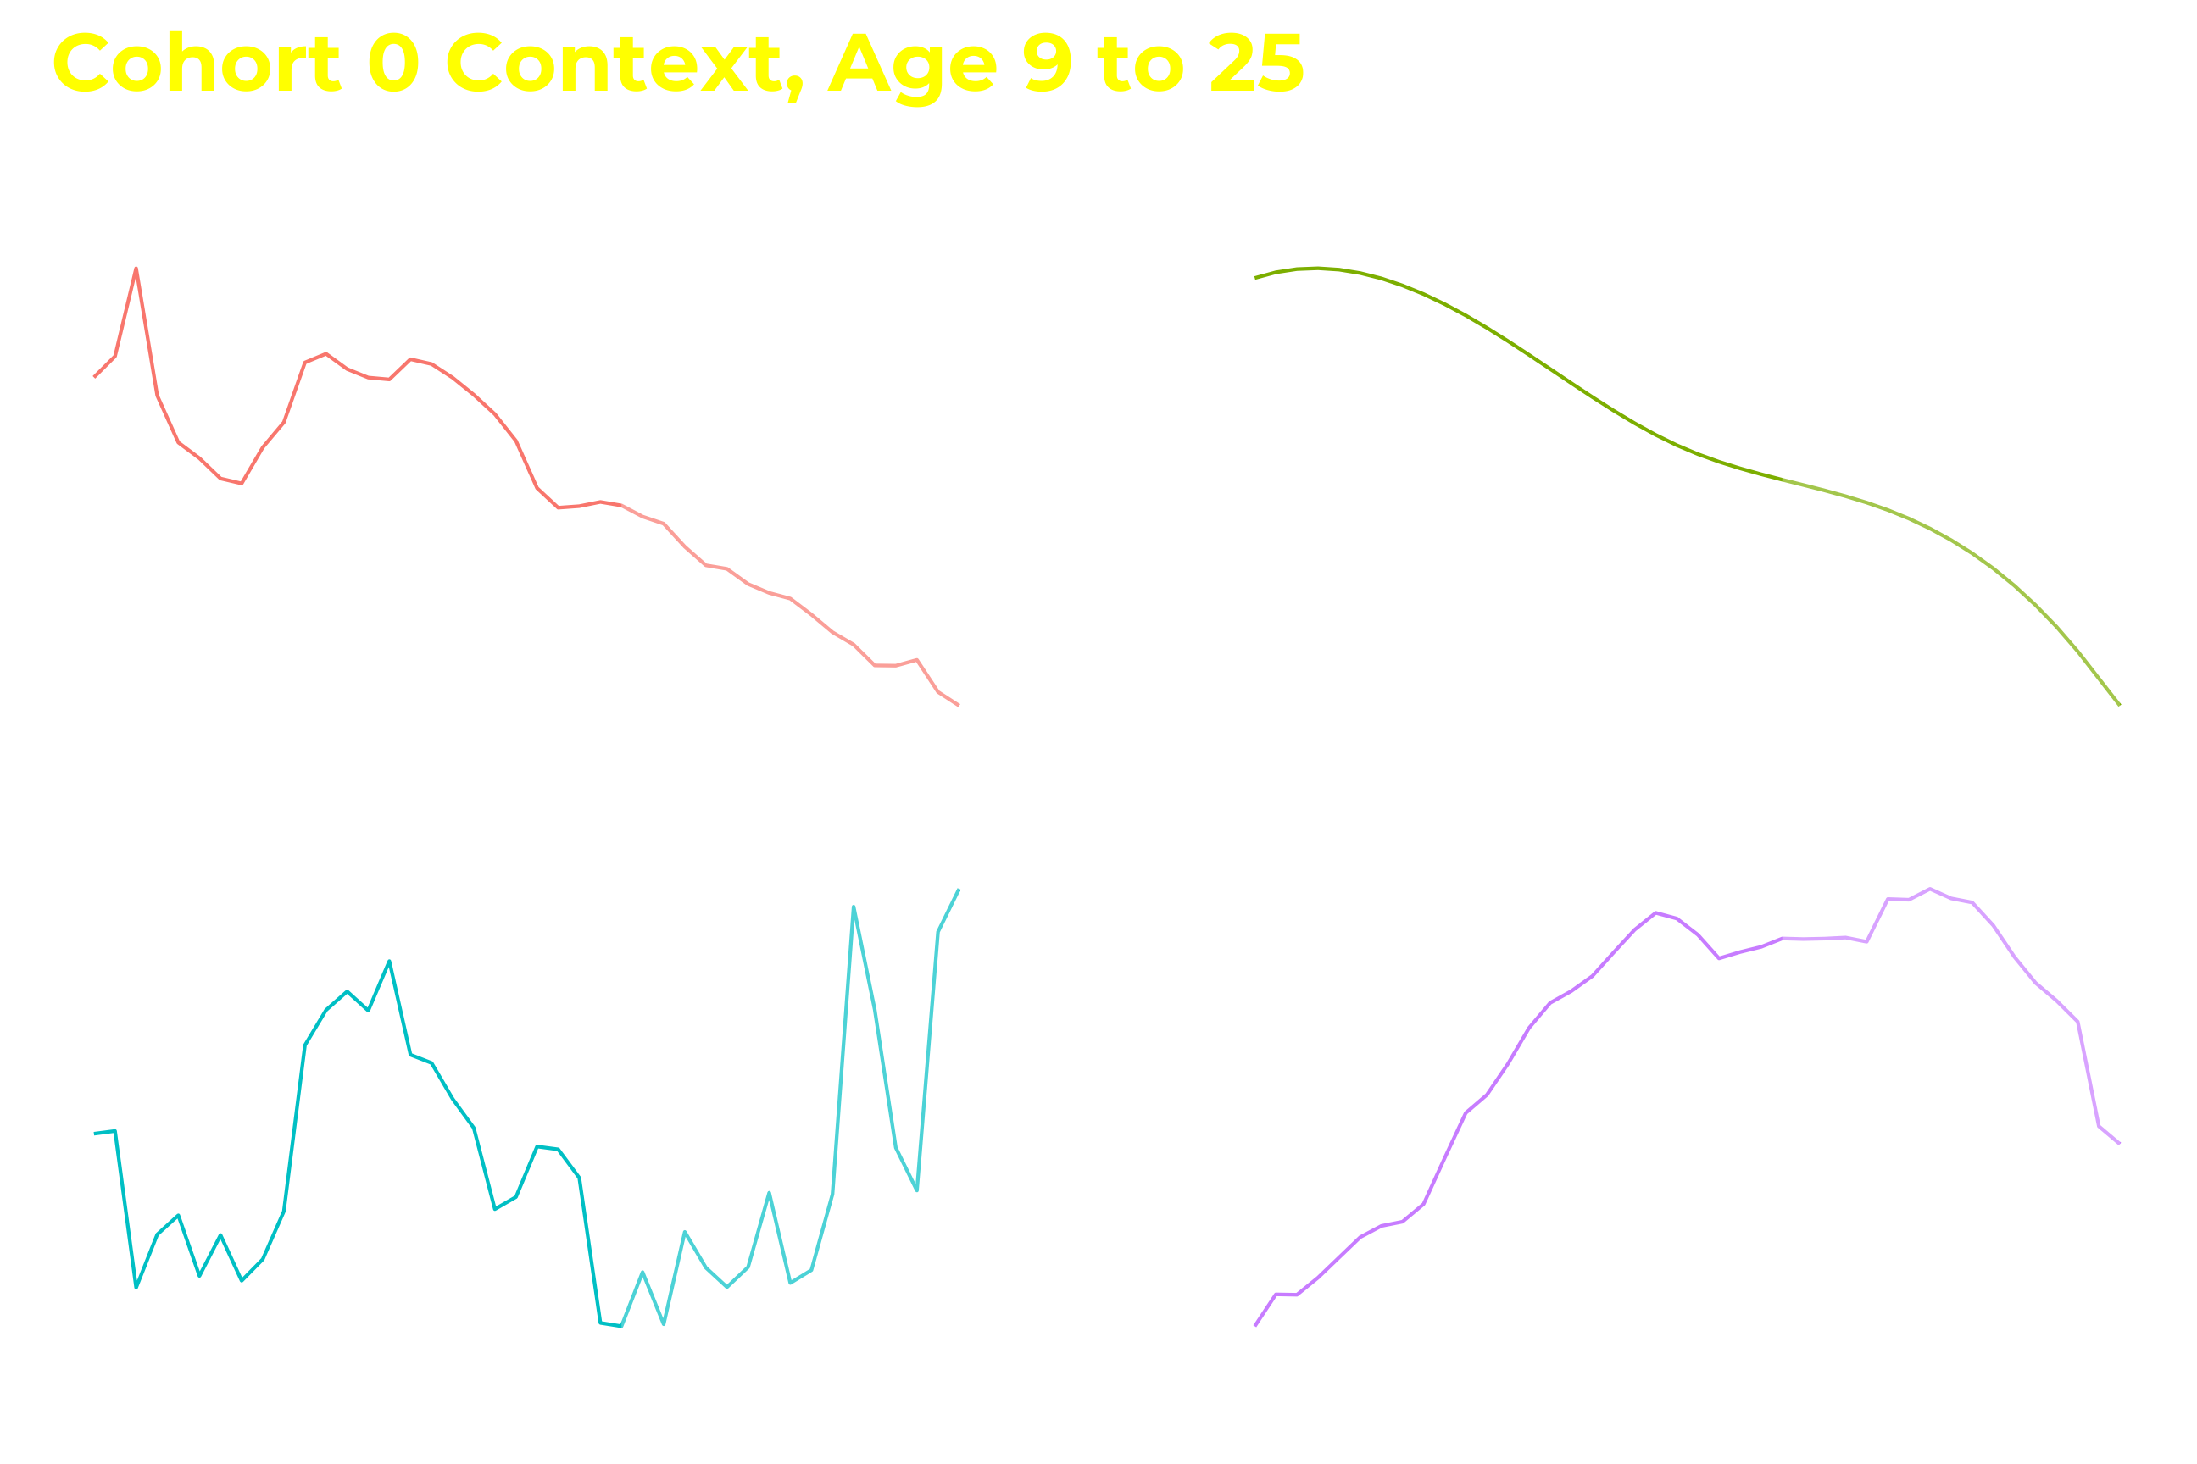
Notes:
Data very rich for linking macrosocial context to individual outcomes

Slide 15

Life-Course Gun Use and Exposures to Gun Violence

Slide 16

Measures
Has the respondent…
ever been shot?
ever seen someone else get shot?
ever carried a concealed gun?
ever used a gun for protection?

Slide 17
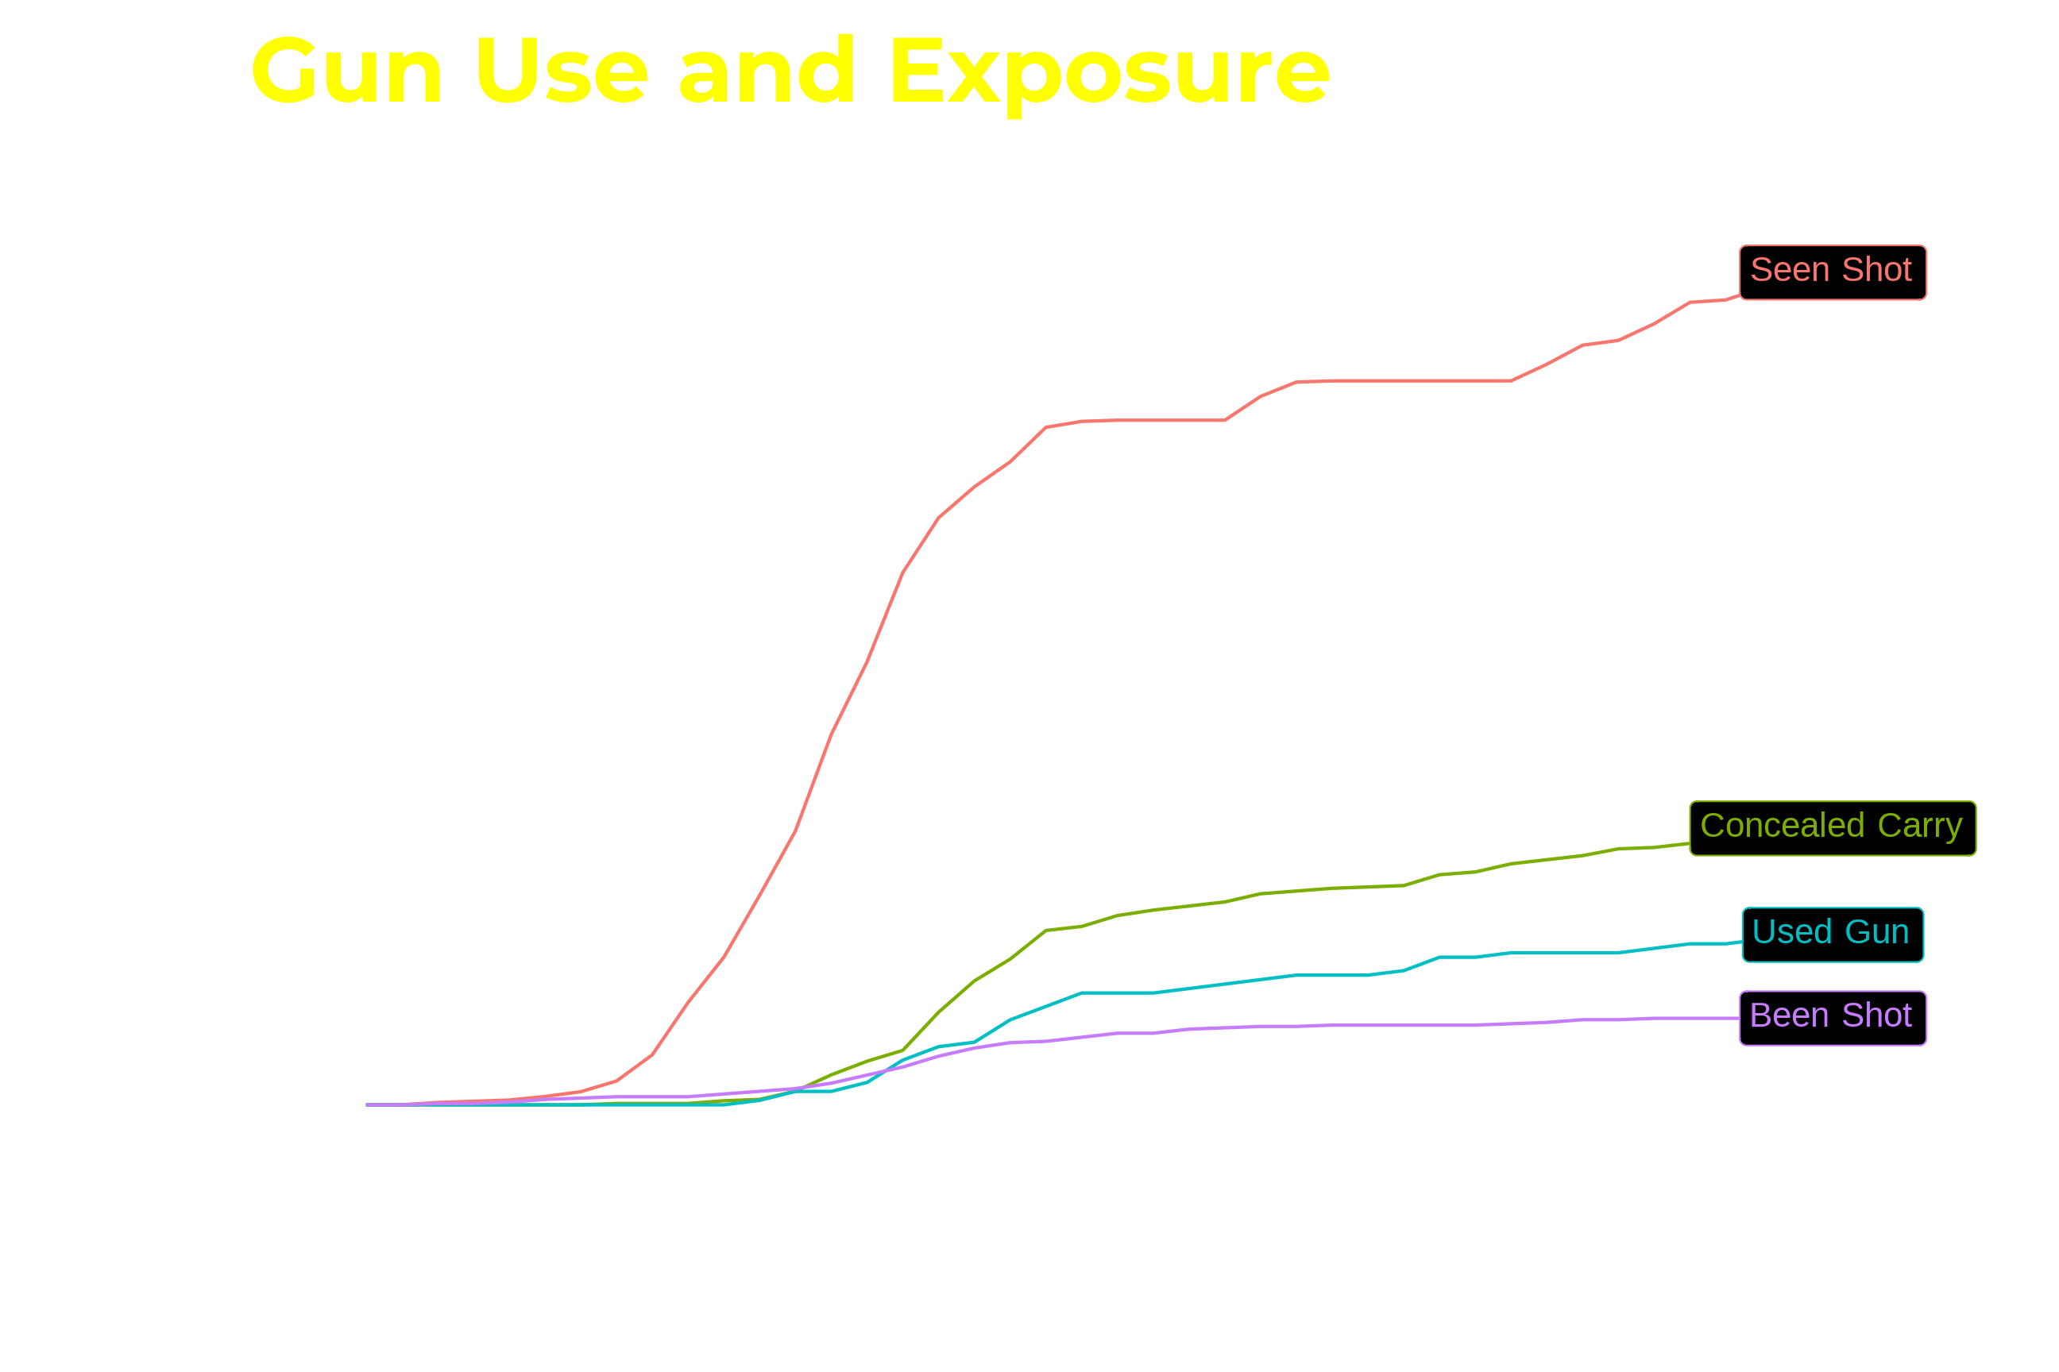
Notes:
ECDF
25% seen someone shot by 40; but already > 20% at 20
Note how rapidly curve rises for seen shot compared to others
Doesn’t account for censoring, but looks similar if you do

Slide 18
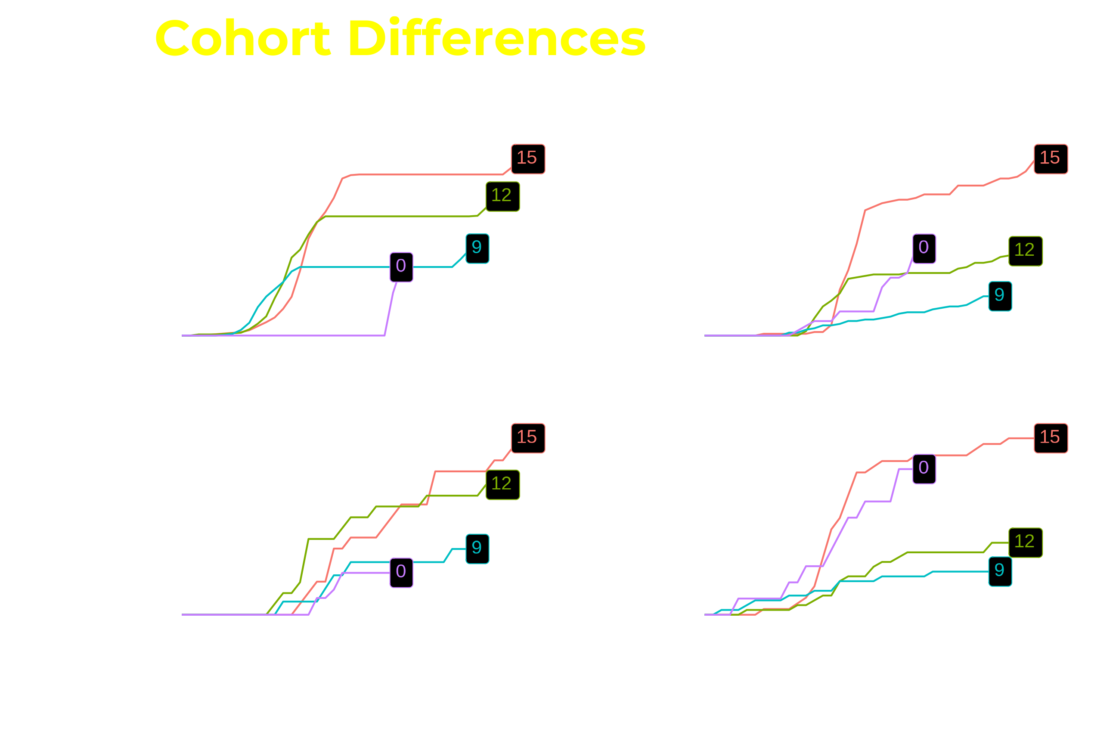
Notes:
Each line is cohort, each pane is outcome
Seen shot looks weird because of interval censoring---real exposure is a smooth curve up to the number
Similarities and differences across outcomes; cohort 0 particularly interesting with been shot so high, seen shot low
Seeing shootings happens at young ages, being shot at older; gun violence was low when they were young, high when older

Slide 19
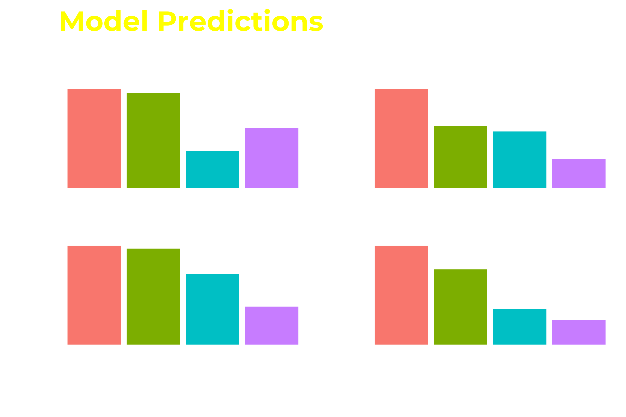
Conditional probabilities with controls for sex, race/ethnicity, immigrant generation,
and childhood exposure to neighborhood violence, disadvantage, and collective efficacy
Notes:
Probability of ever having outcome from logit model

Slide 20

Future Plans
Life course of victimization through mid-adulthood
Reproduction of gun violence
Long-term causal consequences of exposure to violence for health and well-being
The extent and consequences of exposure to police brutality
Residential exposure to levels of gun violence in 2021

Slide 21

Feedback and Questions
Contacts:
Charles C. Lanfear Institute of Criminology University of Cambridge
cl948@cam.ac.uk
For more about the PHDCN+:
PHDCN@fas.harvard.edu
https://sites.harvard.edu/phdcn/
https://doi.org/10.1007/s40865-022-00203-0

